Slide 1

Center for Informed Consent Integrity
Webinar Series – 15 Sep 2021
Mainstreaming informed consent for genomic sequencing: A call for action
with Eline M. Bunnik, PhD, Erasmus University

Slide 2
Purpose
Advance ethical and scientific rigor in research and evidence generation across health, human rights, humanitarian response, education, heritage stewardship, and development

Slide 3
The Foundation focuses its work through “Centers” which align with and benefit from the knowledge and practice domain strengths across our community of practice
Center for Vaccine
Ethics and Policy
Center for Ethics and Policy on Access to Medicines
Center for Disaster and Humanitarian Ethics
Center for Human Rights Research Ethics
Center for Informed Consent Integrity
Center for Sustainable Development Research
Center for Heritage Stewardship Research
Center for Education & Literacy Research

Slide 4

Asymmetric
Interventions
Publishing/Public Comment/Convening/
IC Monthly Review;
Webinar Series;
Symposia
Asymmetric
Interventions
Strategic Program
Advancing Rights & Exercise/Articulating Evolving Capacity
Strategic Theme:
Consent Across Research Disciplines/Cultural Contexts/Governance Models
Center for Informed Consent Integrity
Programmatic Foci
Strategic Program
COVID Vaccines &
Therapeutics+:
Informed Choice/
Consent/Refusal
Strategic Program
Informed Consent in Genomic Medicine
Asymmetric
Interventions
Strategic Program
IC Integrity/Transparency
in Clinical Development
and Translation
Asymmetric
Interventions
Sketch 7.0 at 10 Sep 2021

Slide 5
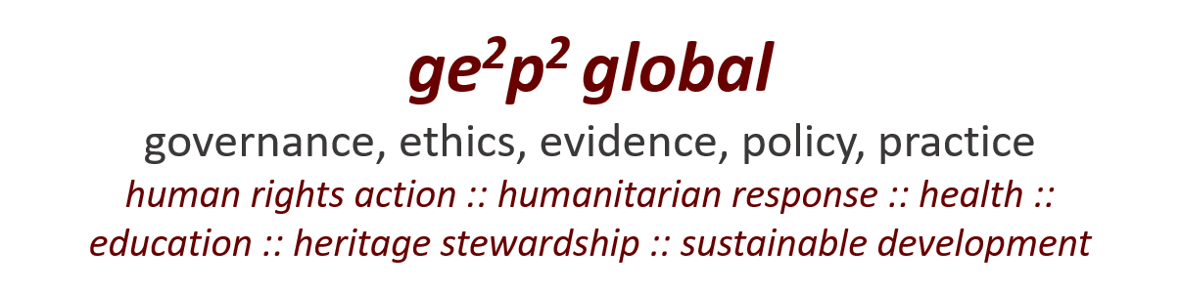
Center for Informed Consent Integrity [CICI]
Webinar Series
15 Sep 2021
Call Focus :: Journal Paper
Mainstreaming informed consent for genomic
sequencing: A call for action
      Host: David R. Curry - President, GE2P2 Global Fdn
      Discussant: Eline M. Bunnik, PhD, Erasmus University. Rotterdam
      Open Forum: Discussion/Observations/Insights/Q&A

Slide 6
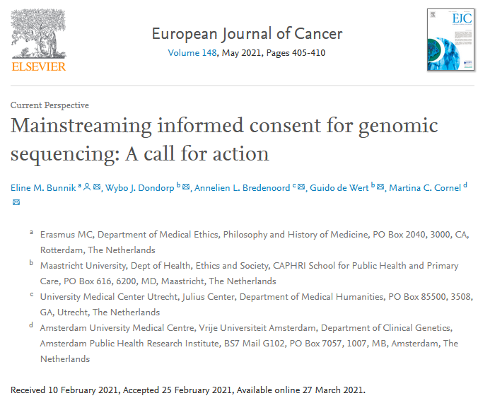
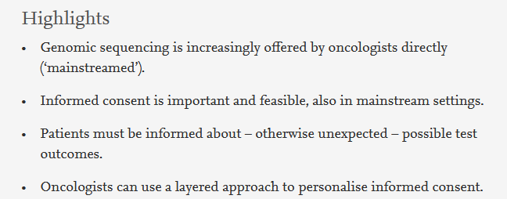

Slide 8
Mainstreaming informed consent for genomic sequencing: A call for action
Current Perspective
Eline M. Bunnik, Wybo J. Dondorp, Annelien L. Bredenoord, Guido de Wert, Martina C. Corneld
European Journal of Cancer, May 2021; 148 pp 405-410
Abstract
The wider availability of genomic sequencing, notably gene panels, in cancer care allows for personalised medicine or the tailoring of clinical management to the genetic characteristics of tumours. While the primary aim of mainstream genomic sequencing of cancer patients is therapy-focussed, genomic testing may yield three types of results beyond the answer to the clinical question: suspected germline mutations, variants of uncertain significance (VUS), and unsolicited findings pertaining to other conditions. Ideally, patients should be prepared beforehand for the clinical and psychosocial consequences of such findings, for themselves and for their family members, and be given the opportunity to autonomously decide whether or not to receive such unsolicited genomic information. When genomic tests are mainstreamed into cancer care, so should accompanying informed consent practices. This paper outlines what mainstream oncologists may learn from the ethical tradition of informed consent for genomic sequencing, as developed within clinical genetics. It argues that mainstream informed consent practices should focus on preparing patients for three types of unsolicited outcomes, briefly and effectively. Also, it argues that when the chance of unsolicited findings is very low, opt-out options need not be actively offered. The use of a layered approach – integrated in information systems – should render informed consent feasible for non-geneticist clinicians in mainstream settings. (Inter) national guidelines for mainstreaming informed consent for genomic sequencing must be developed.
Truth/
Knowledge:
Recognition

Slide 9
Mainstreaming informed consent for genomic sequencing: A call for action
Current Perspective
Eline M. Bunnik, Wybo J. Dondorp, Annelien L. Bredenoord, Guido de Wert, Martina C. Corneld
European Journal of Cancer, May 2021; 148 pp 405-410
Box 3 Layered consent.
Oncologists may use a layered model for informed consent [19]. In layered approaches, the information that is provided as part of the informed consent process is subdivided into layers. In the first layer, essential or ‘material’ information is conveyed – key information that all (reasonable) patients need in order to provide informed consent. Since the early 1970s, this has commonly been referred to as the ‘reasonable person’ standard of disclosure. In the second, third and further layers, additional, more detailed information can be provided if the patient wishes to receive such information.
People differ in their informational needs [21]. The layering of information helps to tailor the information provided to individual patients’ informational needs, and thus, allows for ‘personalisation’ of informed consent. This is referred to as the subjective standard of disclosure [22].
Some people need more information than others in order to provide informed consent. To meet the subjective standard, dialogue (e.g. in the form of pre-test counselling) is indispensable.
Truth/
Knowledge:
Recognition

Slide 10
Mainstreaming informed consent for genomic sequencing: A call for action
Current Perspective
Eline M. Bunnik, Wybo J. Dondorp, Annelien L. Bredenoord, Guido de Wert, Martina C. Corneld
European Journal of Cancer, May 2021; 148 pp 405-410
Box 4
Essential information and examples of brief explanations of the implications.
Truth/
Knowledge:
Germline mutations | ‘This means that your cancer may be hereditary. Knowing this may have consequences for you and for your family members’.
VUS | ‘Today, we do not know what such a finding means, but we may learn more in the future, and we may contact you again once we know more’.
Incidental findings | ‘There is a small chance that we find genetic risks for conditions other than your current condition. You may not wish to learn this information’.
Recognition

Slide 11
Mainstreaming informed consent for genomic sequencing: A call for action
Current Perspective
Eline M. Bunnik, Wybo J. Dondorp, Annelien L. Bredenoord, Guido de Wert, Martina C. Corneld
European Journal of Cancer, May 2021; 148 pp 405-410
In sum, we propose setting a realistic bar for informed consent practices for genomic testing for the purposes of personalised medicine in oncology settings – when appropriate. When gene panels are used, and the likelihood of unsolicited findings is very slim, the option to opt out need not be discussed in the first layer with all patients.
First and foremost, clinicians should focus on helping patients understand – briefly, without too much technical detail – that potential germline mutations, VUS and unsolicited findings pertaining to other conditions may be uncovered – findings that patients may not otherwise expect and which may have a major impact on them and on their family members. This way, patients are not hampered in autonomous decision-making by information overload, while they do receive sufficient information to make the decision to initiate genomic sequencing.
(Inter) national guidelines for mainstreaming informed consent for genomic sequencing must be developed.
Truth/
Knowledge:
Recognition

Slide 12

Defining the Critical Components of Informed Consent for Genetic Testing: A Delphi Study
View ORCID ProfileKelly E. Ormond, Maia Borensztein, View ORCID ProfileMiranda L.G. Hallquist, View ORCID ProfileAdam H. Buchanan, W. Andrew Faucett, View ORCID ProfileHolly L. Peay, Maureen E. Smith, View ORCID ProfileEric P. Tricou, View ORCID ProfileWendy R. Uhlmann, View ORCID ProfileKaren E. Wain, View ORCID ProfileCurtis R. Coughlin II
doi: https://doi.org/10.1101/2021.06.24.21259406 This article is a preprint and has not been peer-reviewed [what does this mean?]. It reports new medical research that has yet to be evaluated and so should not be used to guide clinical practice.
ABSTRACT
Purpose Informed consent for genetic testing has historically happened during pre-test genetic counseling, without specific guidance defining which core concepts are required.
Methods The Clinical Genome Resource (ClinGen) Consent and Disclosure Recommendations Workgroup (CADRe) used a modified Expert Delphi consensus process to identify the core concepts essential to consent for clinical genetic testing. A literature review identified 77 concepts that are included in informed consent for genetic tests. Twenty five experts (9 medical geneticists, 8 genetic counselors, and 9 bioethicists) completed two rounds of Delphi surveys ranking concepts’ importance to informed consent.
Results The most highly ranked concepts included: (1) genetic testing is voluntary; (2) why the test is recommended and what does it test for; (3) what results will be returned and to whom; (4) are there other types of potential results; what choices exist; (5) how will prognosis and management be impacted by results; (6) what is the potential family impact; (7) what are the test limitations and next steps; (8) potential risk for genetic discrimination and legal protections.
Conclusion Defining the core concepts necessary for informed consent for genetic testing provides a foundation for quality patient care across a variety of healthcare providers and clinical indications.

Slide 13
Financial Times, August 31 2021
Opinion - Genomics
Covid has revealed the need for genomic sequencing around the world
Rich countries must act to expand our knowledge of Sars-Cov-2 by establishing close monitoring in poorer nations
Harold Varmus - The writer, a Nobel laureate in physiology or medicine, chairs the WHO Science Council
The rapid spread of the Delta variant of Sars-Cov-2 has dashed hopes that the pandemic might soon be over. It has also raised the prospect that yet more dangerous variants, including those impervious to vaccines or prior infections, might arise.
While we lack complete knowledge of how the most dangerous variants of Sars-Cov-2 are generated, we do know that these emerge through mutations to the genome that occur when the virus replicates. Such mutations are more likely to arise in immune-compromised individuals in whom the virus can replicate repeatedly for extended periods. Variants of special concern are those that infect cells more efficiently or evade immune responses.
As long as the virus is spreading as widely as it is now — particularly in unvaccinated populations found both in wealthy countries with abundant vaccine and in low- and middle-income countries where vaccines are very limited — a substantial fraction of infected individuals needs to be monitored for viral variants.
This cannot be done with the two widely available tests — through the polymerase chain reaction or an antibody test — since these tests are not designed to detect mutations. Instead, genome sequencing, performed by machines that can quickly read the order of the four chemical elements that compose viral genomes, must be used to identify mutations, followed by studies to determine whether any are responsible for changes in the behaviour of the virus…

Slide 14
Truth/
Knowledge:
Open Forum: Discussion/Questions/Observations
Recognition

